Slide 1


Slide 2
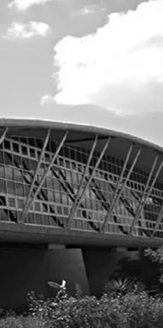

Browser Extension for Facial Expression Recognition
Presented by:
Dorra GARA - Melek ELLOUMI -
Mouheb BEN CHEIKH - Mohamed BEN ATTIA
END OF YEAR PROJECT
INSAT Supervisor : Ms. Dorsaf SEBAI
Presented On: June, 6th 2022

Slide 3
01.
General Context
02.
Project Planning
PRESENTATION
PLAN
03.
State of the Art
04.
Model Training
05.
Chrome Extension Implementation

Slide 4
01. GENERAL CONTEXT

Slide 5
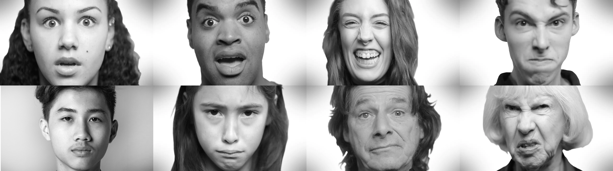
FACIAL EXPRESSION RECOGNITION
01.
04
The classification of facial expressions into universal categories of emotions following a specific configuration of the micro-motors.
Fear
Surprise
Happiness
Anger
Neutral
Sadness
Contempt
Disgust

Slide 6

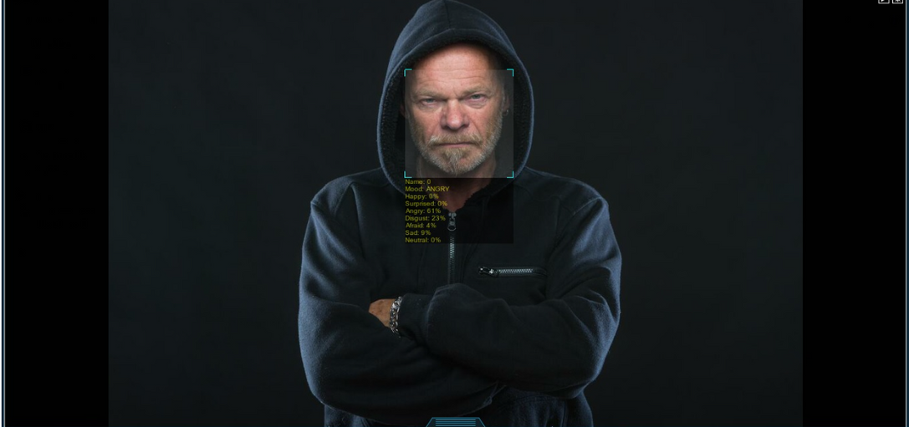
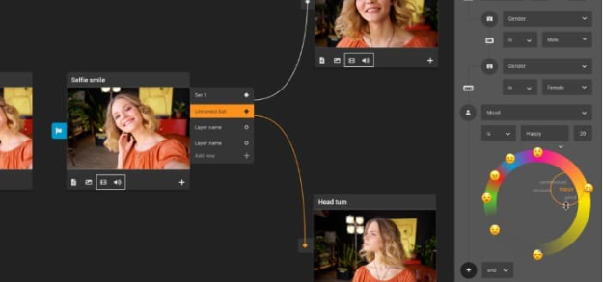

01.
USE CASES
05

Slide 7
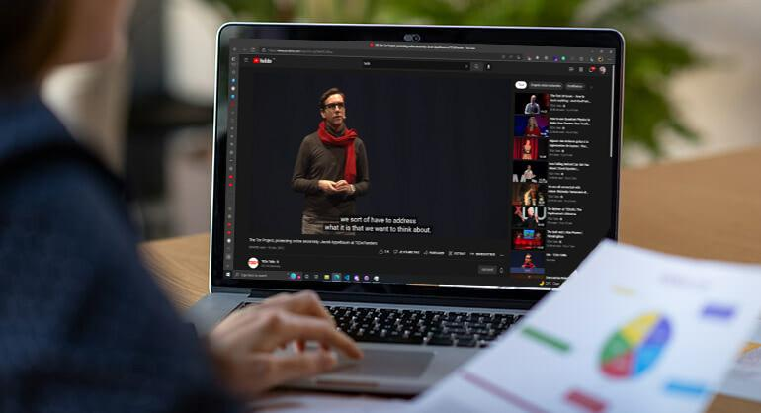

01.
GOAL
06
Offer the possibility for everyone to analyze the emotions of an interlocutor.

Slide 8
02. PROJECT
PLANNING

Slide 9





PROJECT TIMELINE
02.
08
Model Implementation
Deep Learning Fundamentals
1
3
5
Review
Ideation & Presentation
2
Benchmarking
4
Chrome Extension Implementation
6

Slide 10
03. STATE OF
THE ART

Slide 11
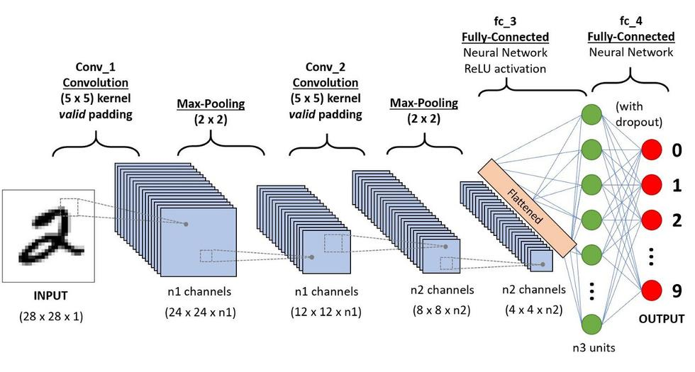
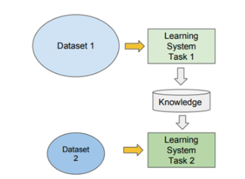
DEEP
LEARNING
03.
10
Form of AI derived from Machine Learning and inspired by the structure and function of the brain.
CONVOLUTIONAL NEURAL NETWORKS
TRANSFER LEARNING

Slide 12
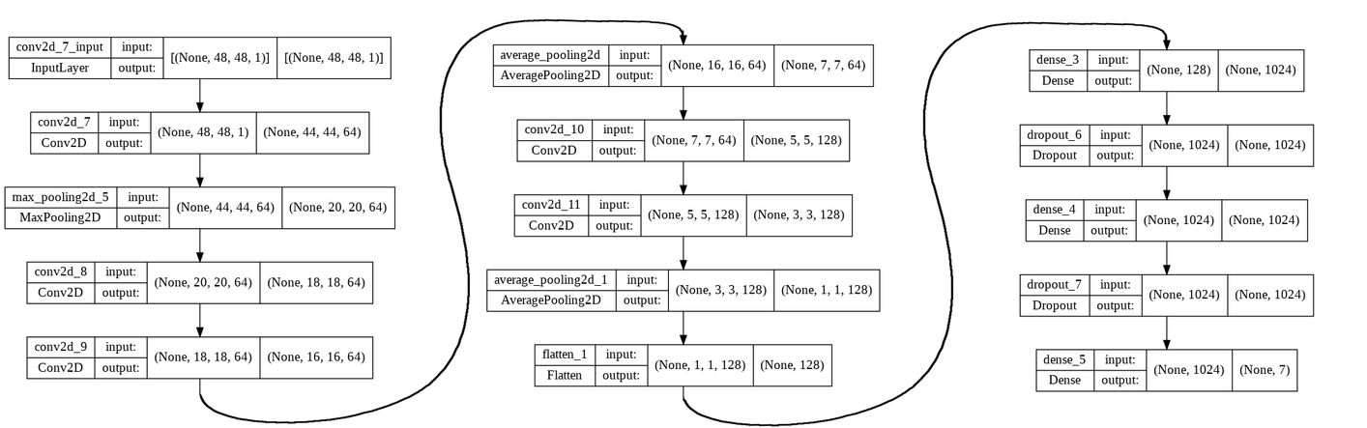
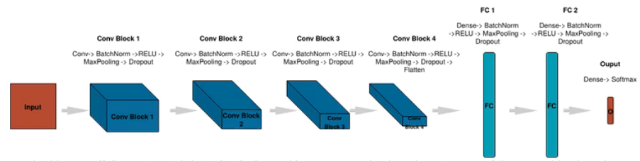
EXISTING MODELS
03.
11
CNN BASED MODELS
DEEPFACE
COURSERA

Slide 13
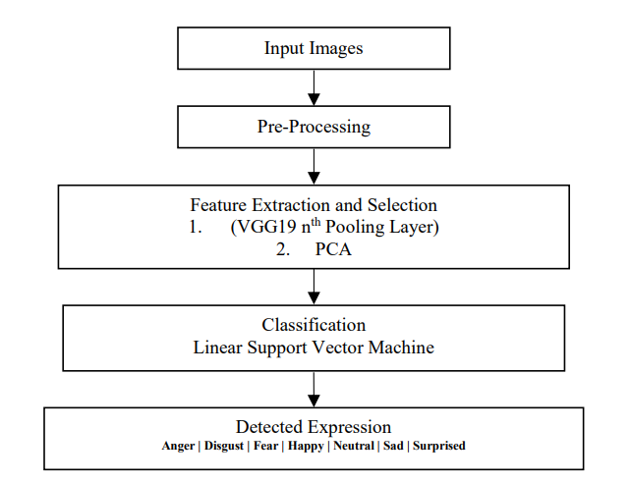
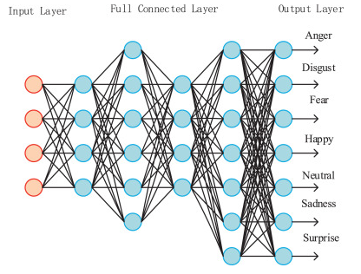
EXISTING MODELS
03.
12
TL BASED MODELS
VGG-19
RESNET-50

Slide 14
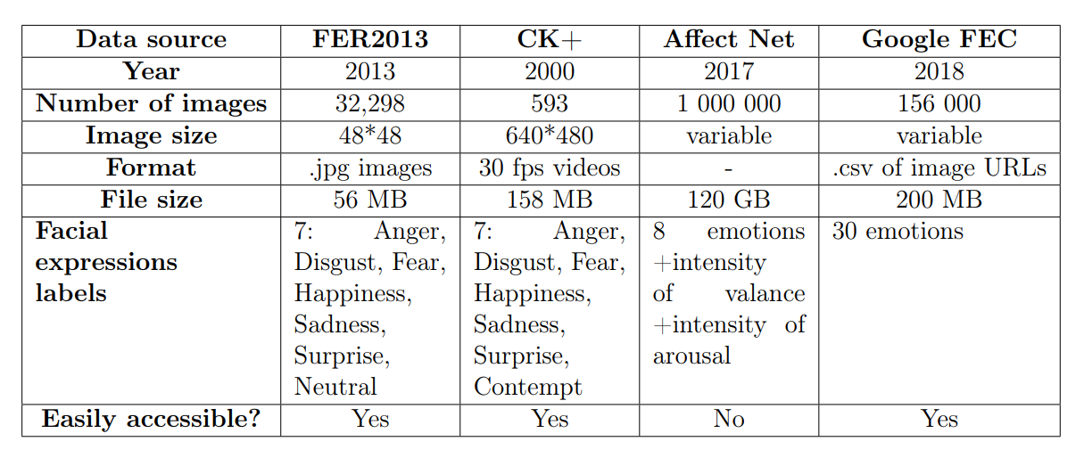
03.
DATASETS
13

Slide 15
04. MODEL
TRAINING

Slide 16


TECHNOLOGIES
USED
04.
15
Python is an interpreted, high-level, dynamic programming language, widely
adopted by the data science community.
Keras is a deep learning library that provides tools to build and train models.

Slide 17
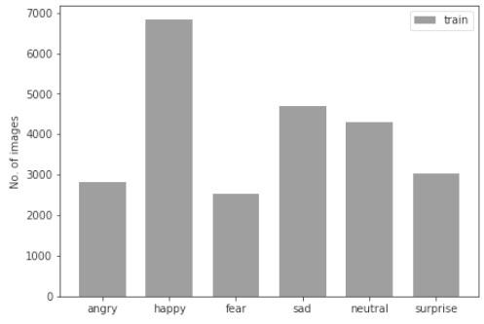
DATASET
PREPROCESSING
04.
16
DATA CLEANING
DATA AUGMENTATION
We deleted wrong images that don't fit the expressions and removed the disgust emotion since it doesn't have enough images.
Data augmentation is a technique that increases the size of a dataset without having to collect new data by providing some variation to the photos.
We applied these augmentations on our dataset:
Horizontal flip
Zoom
Rotation
Shear

Slide 18
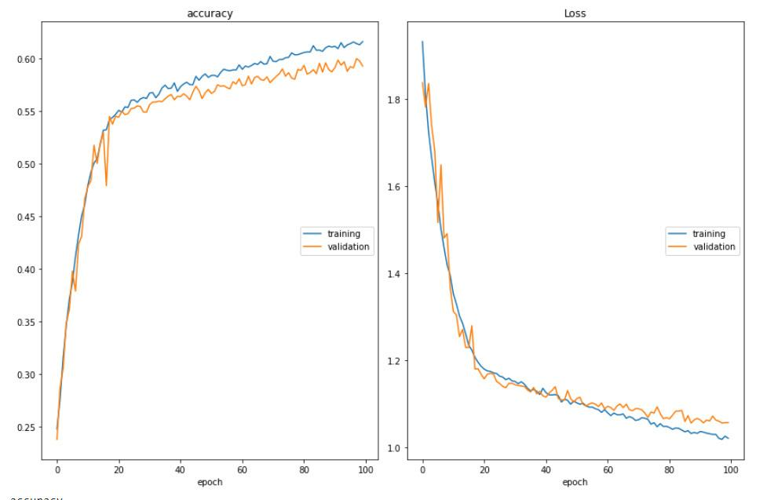
MODEL TRAINING
RESULTS
04.
17
COURSERA
Accuracy: 59.2%

Slide 19
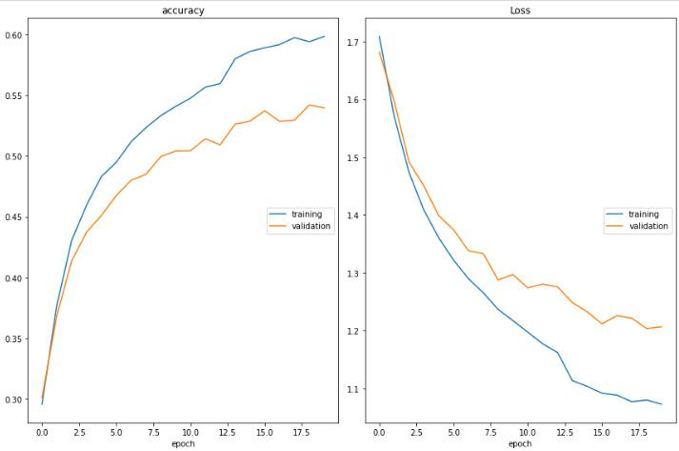
MODEL TRAINING
RESULTS
04.
18
DEEPFACE
Accuracy: 54.2%

Slide 20
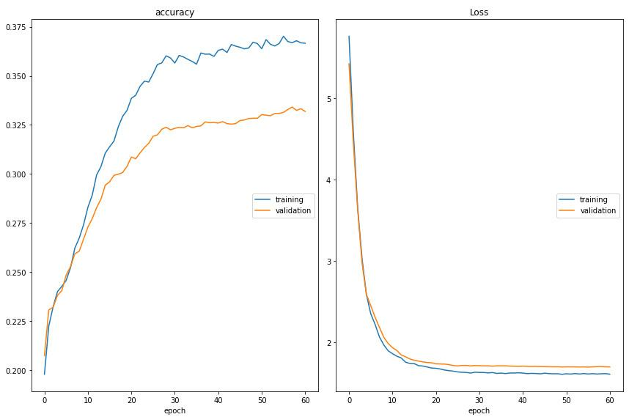
MODEL TRAINING
RESULTS
04.
19
VGG-19
Accuracy: 33.3%

Slide 21
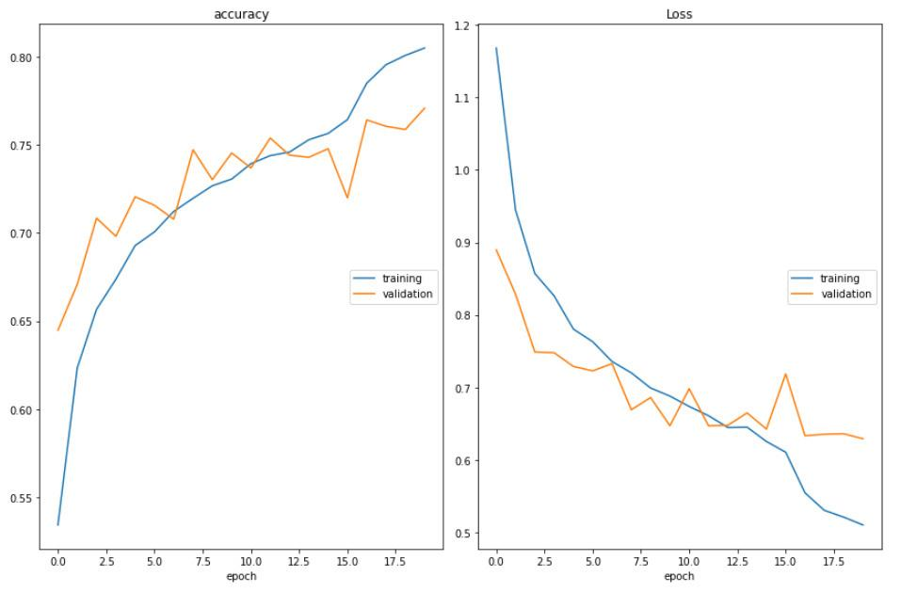
MODEL TRAINING
RESULTS
04.
20
RESNET-50
Accuracy: 75.6%

Slide 22
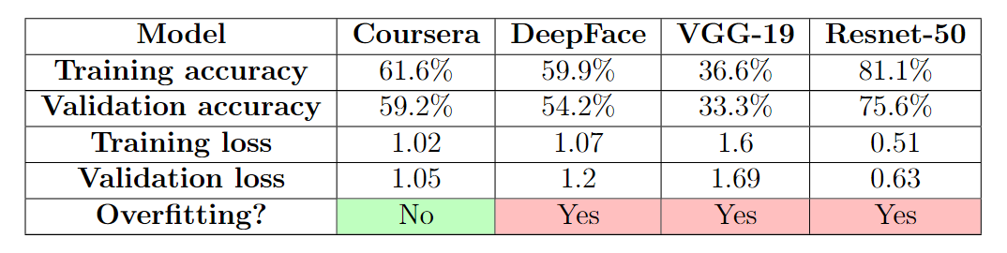
04.
COMPARISON
21
The performances of the Coursera model exceeded other models performances.
We chose to continue with it and optimize it by experimenting on the hyper-parameters.

Slide 23
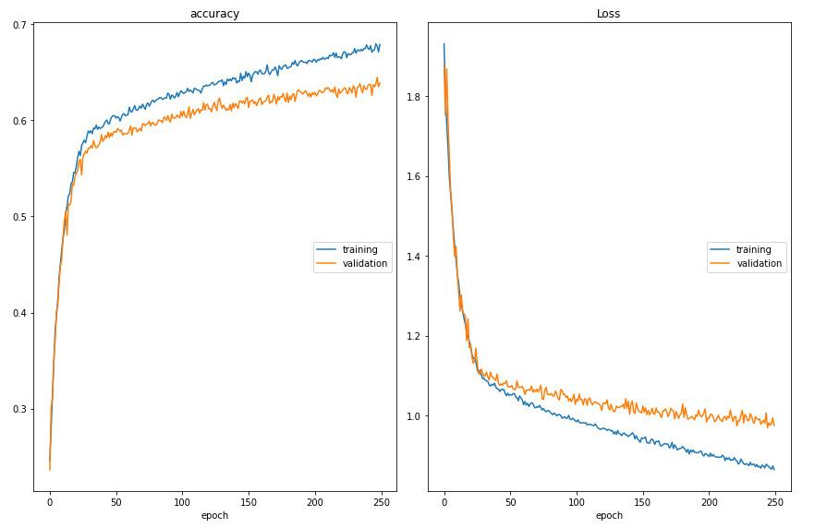
04.
OPTIMIZATION
22
After some trial and error, we reached an optimal accuracy of 63.87% by training the model with these parameters:
250 epochs
16 batch size
0.00005 learning rate

Slide 24
05. CHROME EXTENSION IMPLEMENTATION

Slide 25


TECHNOLOGIES
USED
05.
24
FACE-API.JS
Node.js is an open-source and cross-platform JavaScript runtime environment.
TensorFlow.js is a library for machine learning in JavaScript that enables to use ML directly in the browser or in Node.js
JavaScript API for face detection and face recognition in the browser implemented on top of the Tensorflow.js core API

Slide 26

















IMPLEMENTATION STEPS
05.
25
Video from WEB Page
Resize Image Frames
Prediction
We send resized images to the loaded model to get predictions
Extract video from web page into the chrome extension
Converting Image Frames to greyscale 48x48 inputs
Face Detection
Loading Pre-Trained Model
Displaying Results
Using face-api.js we detect faces from video and extract image frames
Using Tensorflow JS we load our model from distant server
Getting the prediction output and displaying it to the user in the popup page via the extension

Slide 27
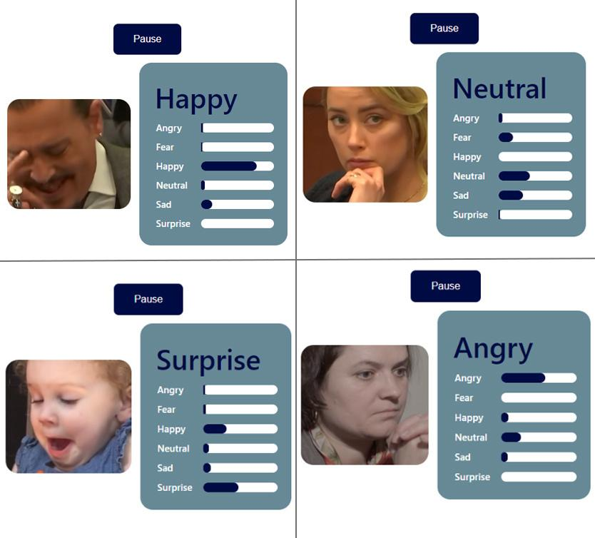
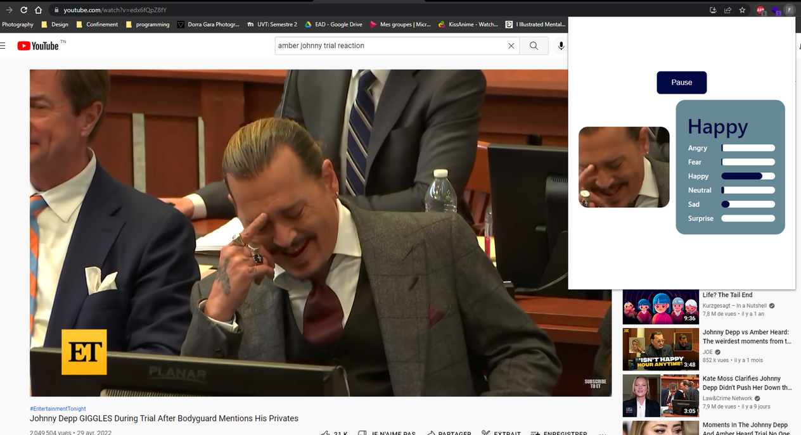
EXTENSION
INTERFACE
05.
26

Slide 28
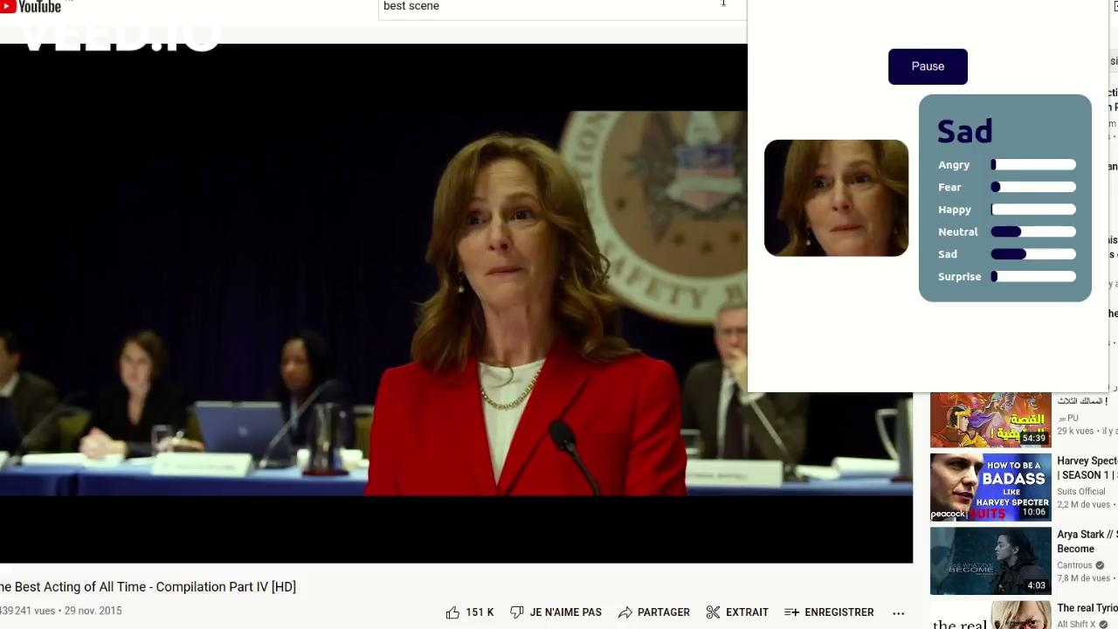
05.
DEMO
27

Slide 29
CONCLUSION
28
research
comparison
testing
accuracy : 63.87%
browser extension
Notes:
research deeplearning
comparaison datasets ,models,
testing with training of models and datasets preprocessing
into getting 63.87%
then we impelmented this browser extension
that made

Slide 30
PERSPECTIVE
29
Increase the accuracy
VER
Notes:
research deeplearning
comparaison datasets ,models,
testing with training of models and datasets preprocessing
into getting 63.87%
then we impelmented this browser extension
that made more simpler

Slide 31

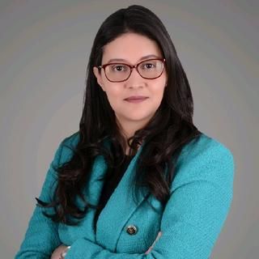
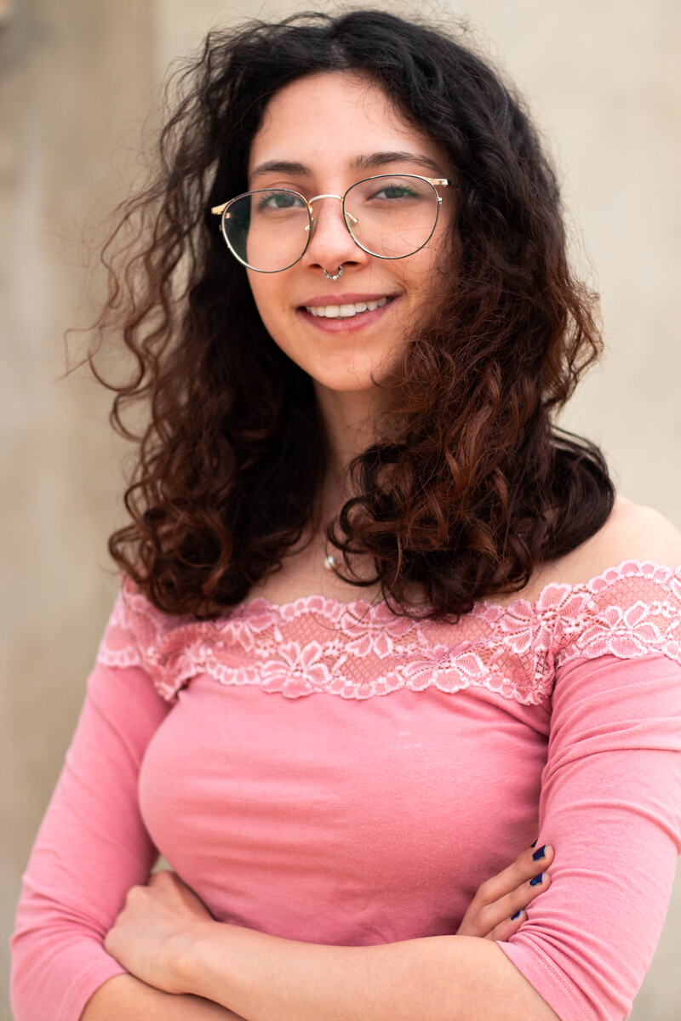
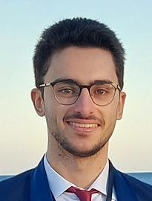
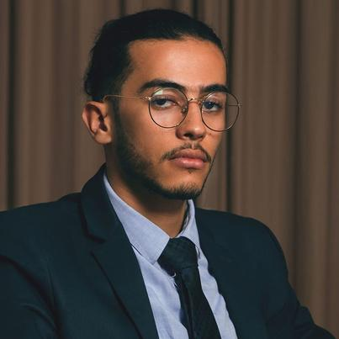

DORSAF SEBAI
INSAT Supervisor
30
DORRA GARRA
THANK YOU FOR YOUR ATTENTION
MELEK ELLOUMI
MOUHEB BEN CHEIKH
MOHAMED BEN ATTIA
Notes:
finally we would’like to thank ms Dorsaf SEBAI for its valuable advice

